Slide 1
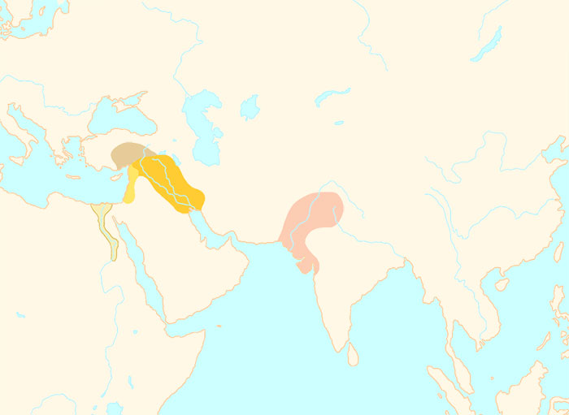
0000 BCE
Egyptian
civilization
Kingdom
of Israel
Hittite
civilization
Aryan
Civilization
Chinese
civilization
Assyrian
Empire
Mesopotamian
civilization
Kingdom
of Kush
Greek
civilization
Minoan
civilization
Persian
Empire
Phoenician
civilization
Indus Valley
civilization
Babylonian
Empire
4000 BCE
1 CE

Slide 2
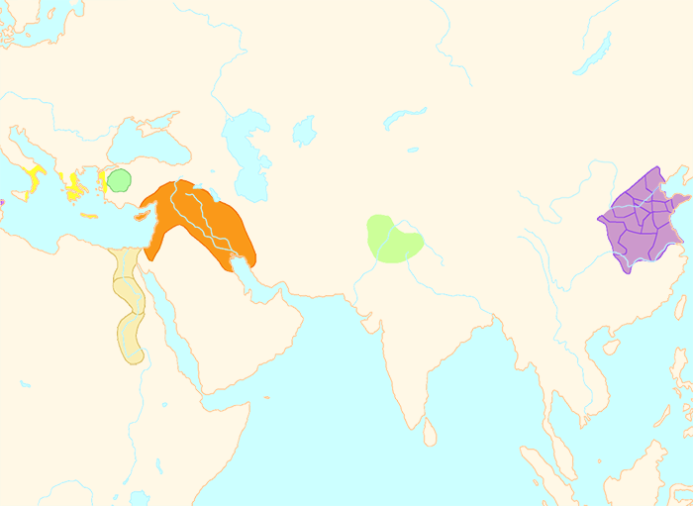
0000 BCE
Egyptian
civilization
Kingdom
of Israel
Hittite
civilization
Aryan
Civilization
Chinese
civilization
Assyrian
Empire
Mesopotamian
civilization
Kingdom
of Kush
Greek
civilization
Minoan
civilization
Persian
Empire
Phoenician
civilization
Indus Valley
civilization
Babylonian
Empire
4000 BCE
1 CE

Slide 3
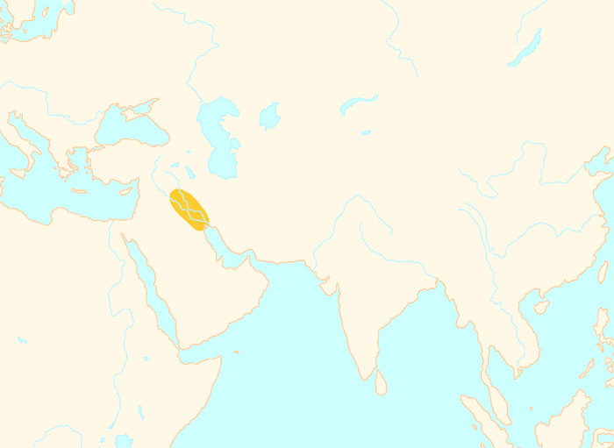
0000 BCE
Egyptian
civilization
Kingdom
of Israel
Hittite
civilization
Aryan
Civilization
Chinese
civilization
Assyrian
Empire
Mesopotamian
civilization
Kingdom
of Kush
Greek
civilization
Minoan
civilization
Persian
Empire
Phoenician
civilization
Indus Valley
civilization
Babylonian
Empire
4000 BCE
1 CE

Slide 4
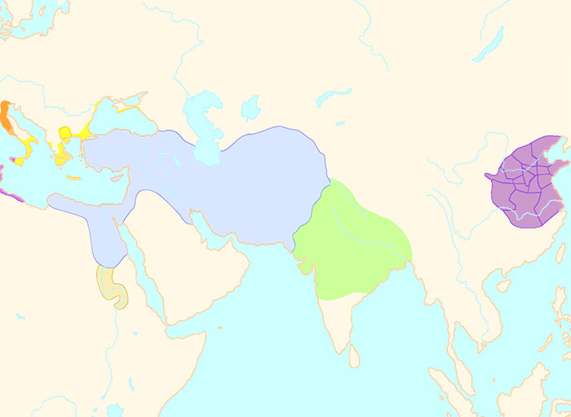
0000 BCE
Egyptian
civilization
Kingdom
of Israel
Hittite
civilization
Aryan
Civilization
Chinese
civilization
Assyrian
Empire
Mesopotamian
civilization
Kingdom
of Kush
Greek
civilization
Minoan
civilization
Persian
Empire
Phoenician
civilization
Indus Valley
civilization
Babylonian
Empire
4000 BCE
1 CE

Slide 5
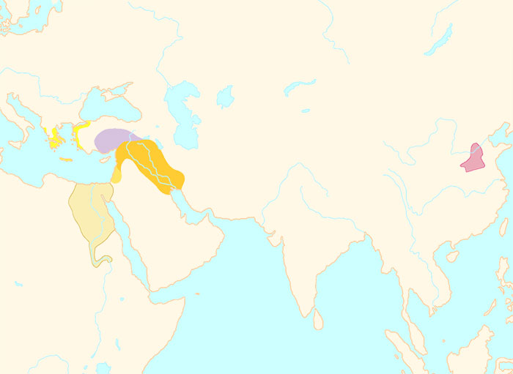
0000 BCE
Egyptian
civilization
Kingdom
of Israel
Hittite
civilization
Aryan
Civilization
Chinese
civilization
China
Assyrian
Empire
Mesopotamian
civilization
Kingdom
of Kush
Greek
civilization
Minoan
civilization
Persian
Empire
Phoenician
civilization
Indus Valley
civilization
Babylonian
Empire
4000 BCE
1 CE

Slide 6
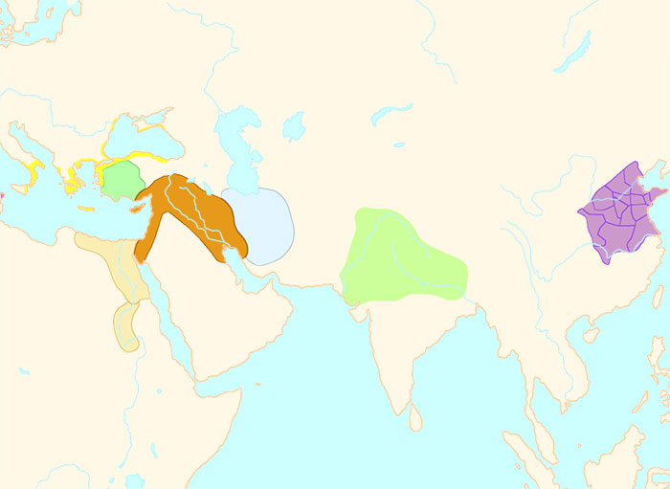
0000 BCE
Egyptian
civilization
Kingdom
of Israel
Hittite
civilization
Aryan
Civilization
Chinese
civilization
Assyrian
Empire
Mesopotamian
civilization
Kingdom
of Kush
Greek
civilization
Minoan
civilization
Persian
Empire
Phoenician
civilization
Indus Valley
civilization
Babylonian
Empire
4000 BCE
1 CE

Slide 7
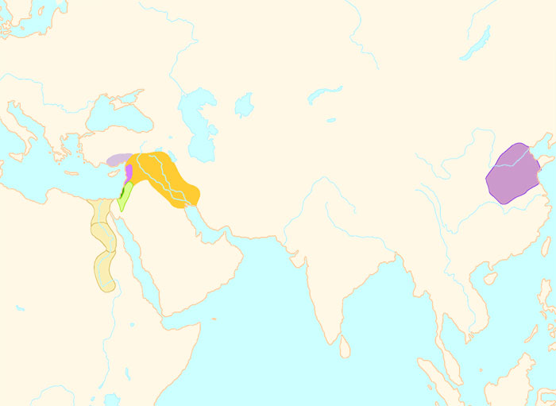
0000 BCE
Egyptian
civilization
Kingdom
of Israel
Hittite
civilization
Aryan
Civilization
Chinese
civilization
Assyrian
Empire
Mesopotamian
civilization
Kingdom
of Kush
Greek
civilization
Minoan
civilization
Persian
Empire
Phoenician
civilization
Indus Valley
civilization
Babylonian
Empire
4000 BCE
1 CE

