Slide 1
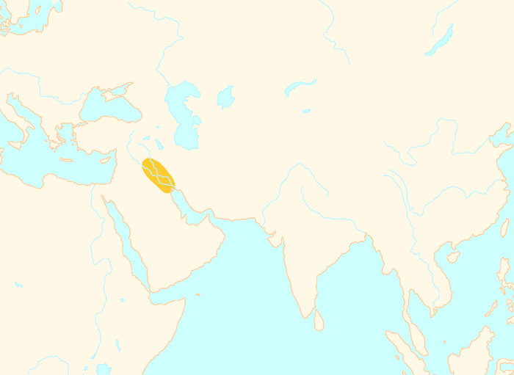
3500 BCE
Mesopotamian
civilization
The earliest cities
are appearing
4000 BCE
1 CE

Slide 2
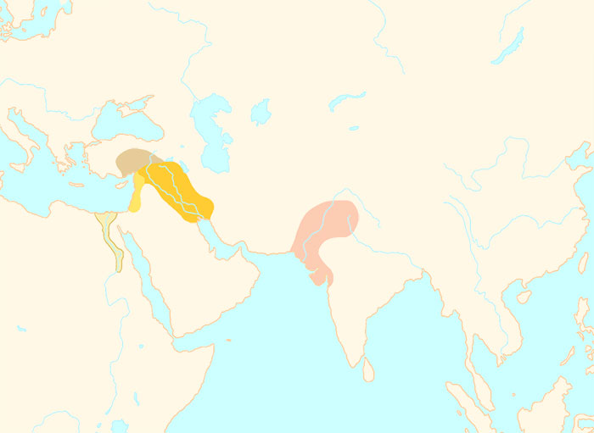
2500 BCE
Mesopotamian
civilization
Indus Valley
civilization
Egyptian
civilization
Well-laid out streets,
drains and sewers
Pyramids of Giza
are being built
4000 BCE
1 CE

Slide 3
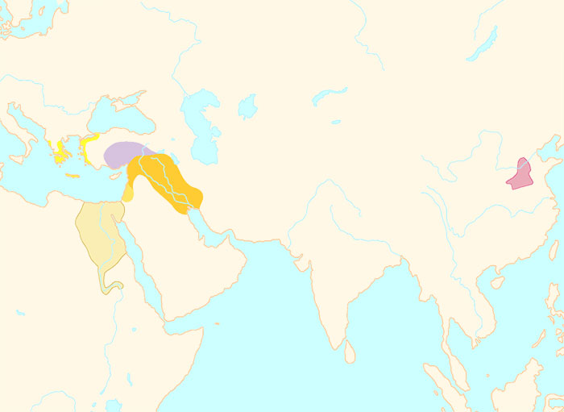
1500 BCE
A great palace has
been built at Knossos
Hammurabi has issued
his famous Law Code
Hittite
civilization
Minoan
civilization
Chinese
civilization
Mesopotamian
civilization
Oracle bones
are in use
Egyptian
civilization
Warlijke pharaohs expand
Egypt’s borders
4000 BCE
1 CE

Slide 4
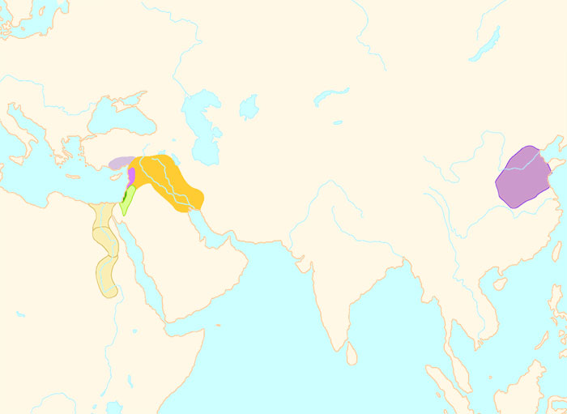
1000 BCE
Traders spread the
alphabet from here
Phoenician
civilization
Mesopotamian
civilization
Chinese
civilization
Kingdom
of Israel
The Vedas are
being composed
The Zhou dynasty has
replaced the
Shang dynasty
Egyptian
civilization
4000 BCE
1 CE

Slide 5
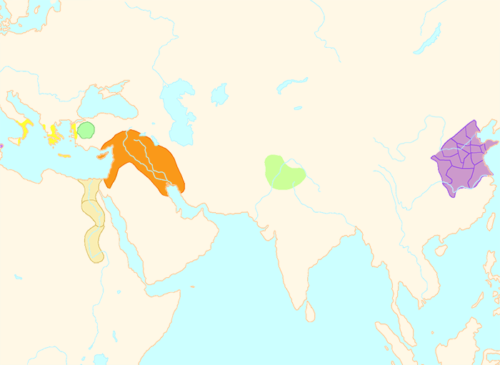
700 BCE
The Olympic games are
now held every 4 years
Greek
civilization
Assyrian
Empire
Chinese
civilization
Aryan
Civilization
Egyptian
civilization
4000 BCE
1 CE

Slide 6
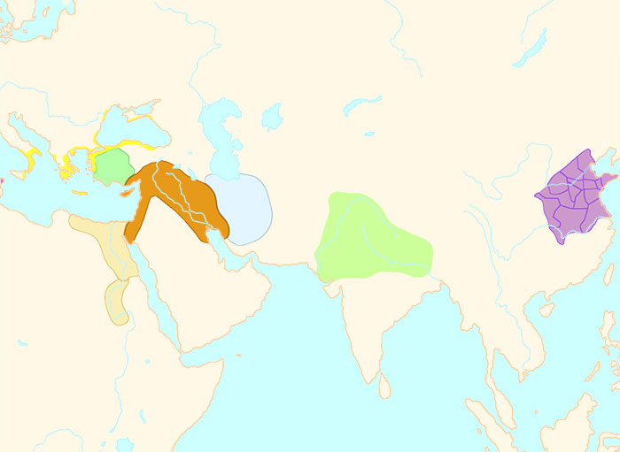
600 BCE
King Nebuchadnezzar
reigns
Greek
civilization
Babylonian
Empire
Chinese
civilization
Aryan
Civilization
Egyptian
civilization
4000 BCE
1 CE

Slide 7
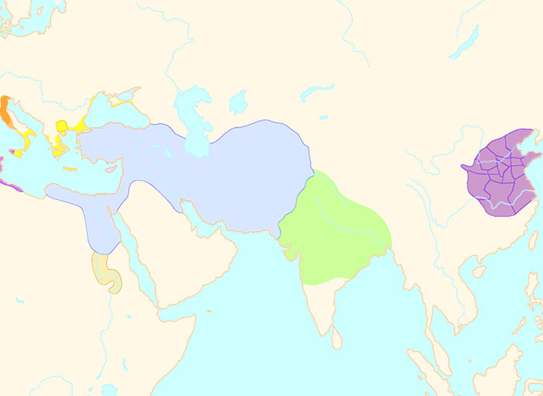
500 BCE
Greek
civilization
Athens has becomes
a democracy
Persian
Empire
Chinese
civilization
Confucius is
teaching now
Cyrus the Great
has conquered
a huge empire
Aryan
Civilization
The Buddha is
teaching now
Kingdom
of Kush
4000 BCE
1 CE

