Slide 1
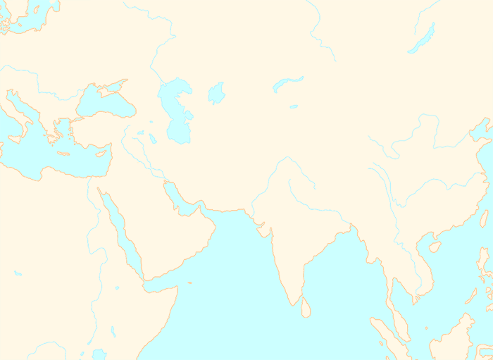
RIVERS:
Indus
Yellow River
Euphrates
Ganges
Yangtze
Nile
Tigris
LANDSCAPES:
Sahara Desert
Arabian Desert
Hindu Kush
Himalayas
Tibetan Plateau
Gobi Desert
Central Asian Steppes
SEAS AND OCEANS:
The Mediterranean Sea
The Indian Ocean
The Red Sea
The Persian Gulf

